Slide 1
Unit 1 Internet and WWW
By :Prof. Abhishek Mehta
Asst. Prof.
PICA- BCA

Slide 2
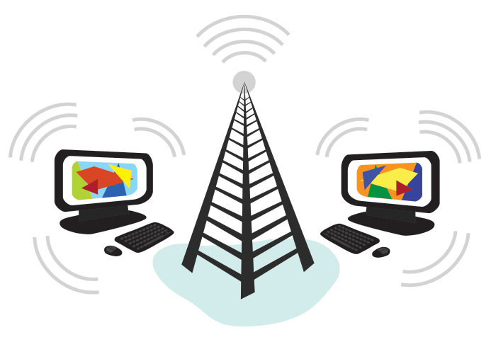

Slide 3
The Internet is a global network of billions of computers and other electronic devices.
With the Internet, it's possible to access almost any information, communicate with anyone else in the world,

Slide 4
What is Internet?
The Internet is a global collection of computer networks that are linked together by devices called routers and use a common set of protocols for data transmission known as TCP/IP (transmission control protocol / Internet protocol).
The primary purpose of the Internet is to facilitate the sharing of information.
A global computer network providing a variety of information and communication facilities, consisting of interconnected networks using standardized communication protocols.
The Internet is a global network of billions of computers and other electronic devices. With the Internet, it's possible to access almost any information, communicate with anyone else in the world, and do much more.

Slide 5
Internet is defined as an Information super Highway, to access information over the web. However, It can be defined in many ways as follows:
Internet is a world-wide global system of interconnected computer networks.
Internet uses the standard Internet Protocol (TCP/IP).
Every computer in internet is identified by a unique IP address.
IP Address is a unique set of numbers (such as 110.22.33.114) which identifies a computer location.
A special computer DNS (Domain Name Server) is used to give name to the IP Address so that user can locate a computer by a name.
For example, a DNS server will resolve a name http://www.tutorialspoint.com to a particular IP address to uniquely identify the computer on which this website is hosted.
Internet is accessible to every user all over the world.

Slide 6
Some attributes
TCP/IP protocols
In order for a computer to communicate on the Internet, a set of rules or protocols computers must follow to exchange messages was developed. The two most important protocols allowing computers to transmit data on the Internet are Transmission Control Protocol (TCP) and Internet Protocol (IP). With these protocols, virtually all computers can communicate with each other.
Domain name system
An Internet address has four fields with numbers that are separated by periods or dots. This type of address is known as an IP address. Rather than have the user remember long strings of numbers, the Domain Name System (DNS) was developed to translate the numerical addresses into words. For example, the address fcit.usf.edu is really 131.247.120.10.

Slide 7
URLs Addresses for web sites are called URLs (Uniform Resource Locators). Most of them begin with http (HyperText Transfer Protocol), followed by a colon and two slashes.
Top-level domain names include:.
.com Commercial
.edu Educational
.gov US Government
.int Organization
.mil US Military
.net Networking Providers
.org Non-profit Organization

Slide 8
History of internet
The concept of Internet was originated in 1969 and has undergone several technological & Infrastructural changes.
The origin of Internet devised from the concept of Advanced Research Project Agency Network (ARPANET).
ARPANET was developed by United States Department of Defense.
Basic purpose of ARPANET was to provide communication among the various bodies of government.
Initially, there were only four nodes, formally called Hosts.
In 1972, the ARPANET spread over the globe with 23 nodes located at different countries and thus became known as Internet.
By the time, with invention of new technologies such as TCP/IP protocols, DNS, WWW, browsers, scripting languages etc., Internet provided a medium to publish and access information over the web.
The first message was sent over the ARPANET from computer science professor Leonard Kleinrock’s laboratory at University of California to the standard research Institute.

Slide 9
The Internet acts as a pipeline to transport electronic messages from one network to another network. At the heart of most networks is a server, a fast computer with large amounts of memory and storage space. The server controls the communication of information between the devices attached to a network, such as computers, printers, or other servers.

Slide 10
How internet works?
It's important to realize that the Internet is a global network of physical cables, which can include copper telephone wires, TV cables, and fiber optic cables.
Even wireless connections like Wi-Fi and 3G/4G rely on these physical cables to access the Internet.
When you visit a website, your computer sends a request over these wires to a server.
A server is where websites are stored, and it works a lot like your computer's hard drive.
Once the request arrives, the server retrieves the website and sends the correct data back to your computer.
What's amazing is that this all happens in just a few seconds!

Slide 11
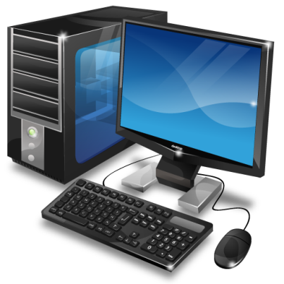
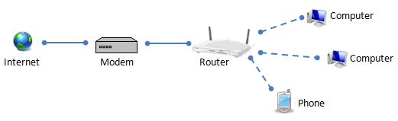
Specification and establishment details
To connect to the Internet you need the following four things:
To connect the internet following four things are necessary:
1) Computer
2) Modem : Modem is a device that you will need to get your computer & broadband working together.
.

Slide 12
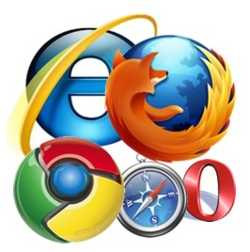
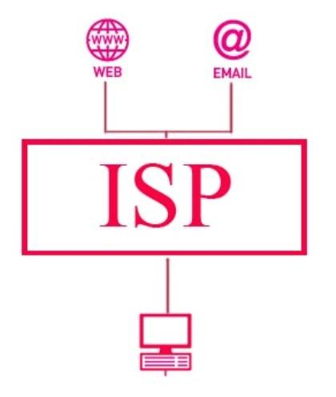
3) Internet Browser : It is a software that you can view web pages.
4) An Account with Internet Service Provider (ISP) : It is an internet company that provides internet service to customer.

Slide 13
Advantage and disadvantage of internet
The most popular and innovative creation in the world of technology is the Internet. The internet is the place where all kinds of information is present and even the communication process is possible using the internet. The world has now become internet dependent because of its vast advantages.
One can surf for any kind of information over the internet. Information regarding various topics such as Technology, Health & Science, Social Studies, Geographical Information, Information Technology, Products etc can be surfed with help of a search engine.
Internet allows us to use many services like:
Internet Banking
Matrimonial Services
Online Shopping
Online Ticket Booking
Online Bill Payment
Data Sharing
E-mail

Slide 14
Advantage of Internet
COMMUNICATION:
The main advantage of internet is the faster communication than any other devices. It’s an instant process. Communication in the form of video calls, emails etc. is possible using internet. Thus, there is no specific region that can be accessed. It is accessible all over the world. Hence, because of this global issues are reduced since video conferencing is possible where everyone across the world can be in single place and can solve out a problem.
INFORMATION:
The internet is the source of knowledge. All kinds of information is present in it. it is easily accessed and can be searched more to get more additional knowledge. Information like educational related, government laws, market sales, stocks and shares, new creations etc. is gathered from a single place.
LEARNING:
The internet has now become a part of education. Education like home schooling is easily carried out using internet. Teachers can upload their teaching videos in the internet and is accessed by people across the world which is helpful for all students. The marks are also released in the internet since, releasing mark for the whole institution in notice boards will create chaos.

Slide 15
Advantage of Internet
ENTERTAINMENT:
The internet is now the most popular form of entertainment. Movies, songs, videos, games etc. is available in internet for free. Social networking is also possible using internet. Hence, there is tons of entertainment that is available in online in the internet.
SOCIAL NETWORK:
The social networking is the sharing of information to people across the world. Apart from being an entertainment website, it has many uses. Any job vacancy, emergency news, ideas etc. can be shared in the website and the information gets passed on quickly to wide area. Also the Social Networking websiter are used to easy communications. Example: Facebook and twitter.
E-COMMERCE:
All business deals can be carried in the internet like transaction of money etc. this is called E commerce. Online reservations, online ticket booking for movie etc. can be done easily. It saves us lots of time. Online shopping is now the latest trend in internet world where products from dresses to household furniture is available at door step.

Slide 16
Disadvantage
There are always chances to loose personal information such as name, address, credit card number. Therefore, one should be very careful while sharing such information. One should use credit cards only through authenticated sites.
Another disadvantage is the Spamming. Spamming corresponds to the unwanted e-mails in bulk. These e-mails serve no purpose and lead to obstruction of entire system.
Virus can easily be spread to the computers connected to internet. Such virus attacks may cause your system to crash or your important data may get deleted.
There are various websites that do not provide the authenticated information. This leads to misconception among many people.

Slide 17
Disadvantage of Internet
INFORMATION LOSS:
The information crucial to us or any important files can be easily taken by the hackers. There is no exact proof for the security for the details we store like account number, passwords etc. hence, sensitive information must be carefully stored by the people.
SPAM:
The unnecessary emails, advertisements etc. sometimes are said to be spam because they have the ability to slow down the system and makes the users to face lots of problems. Spam makes the people get more confused since important emails are also stored along with spam.
VIRUS ATTACKS:
The malware or virus threats are so deadly that affects the system to a greater extend. It immediately deletes all important files and finally the system ends up being crashed. The virus attack is possible in three ways. One it attacks selected files. Two, it harms the executable boot files and most dangerous of all is the macro virus which has the ability to replicate and expand to all parts of files.

Slide 18
Intranets and Extranets
What is intranet?
Intranet is a restricted version of the internet, that typically does not allow access to anyone outside of its network.
An intranet is typically a local only network.
Intranet is defined as private network of computers within an organization with its own server and firewall.
Intranets may be used for organizations or networks that do not want their information to be able to be accessed by outside sources, and is especially important for organizations that require a high amount of secrecy - such as a server that holds military secrets or a database for the CIA. (Central Intelligence Agency)
Intranets are basically mini versions of the internet that connect just a few servers, instead of the countless number of servers that the internet holds and connects with one another.
It is mostly used by company, school, government or organization.

Slide 19
Advantages
Communication : Intranet offers easy and cheap communication within an organization. Employees can communicate using chat, e-mail or blogs.
Cost Effective : Employees can see the data and other documents using browser rather than printing them and distributing duplicate copies among the employees, which certainly decreases the cost.
Security : Since information shared on intranet can only be accessed within an organization, therefore there is almost no chance of being theft.
Immediate Updates : Any changes made to information are reflected immediately to all the users.
Time Saving : Information on Intranet is shared in real time.
Collaboration : Information is distributed among the employees as according to requirement and it can be accessed by the authorized users, resulting in enhanced teamwork.

Slide 20
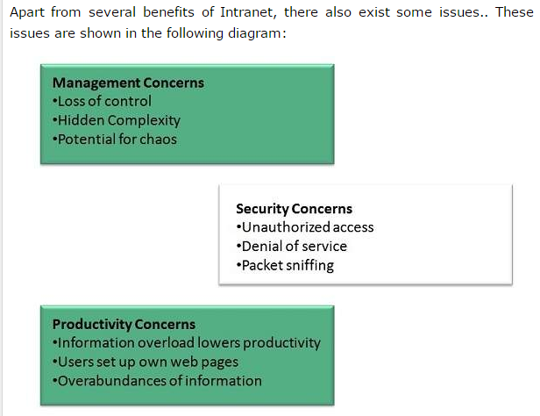
Disadvantage

Slide 21
What is Extranet?
An extranet is like an intranet, but also provides controlled access to authorized customers, vendors, partners, or others outside the company.
The important thing to bear in mind is that extranets exist to create a path of communication between your internal staff and external organizations, whether they be customers, suppliers, or business partners.
An extranet provides a place for your business and third parties to work together and share information in a secure environment, which sits outside of your intranet – meaning that external partners will not have access to confidential internal matters.
An Extranet is actually an Intranet that is partially accessible to authorized outsiders.
The level of access can be set to different levels for individuals or groups of outside users. The access can be based on a username and password or an IP address.
Extranet is used for specific use cases including B-2-B.

Slide 22
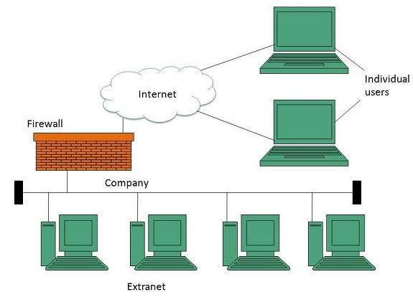
An extranet is an extended intranet. In addition to allowing access to members of an organization, an extranet uses firewalls, access profiles, and privacy protocols to allow access to users from outside the organization.

Slide 23
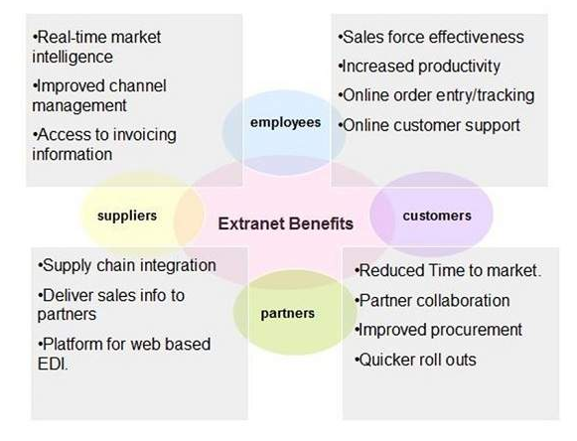
Advantage of extranet

Slide 24
Disadvantage
Hosting : Where the extranet pages will be held i.e. who will host the extranet pages. In this context there are two choices:
Host it on your own server.
Host it with an Internet Service Provider (ISP) in the same way as web pages.
But hosting extranet pages on your own server requires high bandwidth internet connection which is very costly.
Security : Additional firewall security is required if you host extranet pages on your own server which result in a complex security mechanism and increase work load.
Accessing Issues : Information can not be accessed without internet connection. However, information can be accessed in Intranet without internet connection.
Decreased Interaction : It decreases the face to face interaction in the business which results in lack of communication among customers, business partners and suppliers.

Slide 25
More about intranet and extranet
http://www.brighthub.com/computing/enterprise-security/articles/63387.aspx
http://www.hcidata.info/inet.htm
https://www.claromentis.com/blog/whats-the-difference-between-intranets-and-extranets/
http://www.differencebetween.info/difference-between-intranet-and-extranet

Slide 26



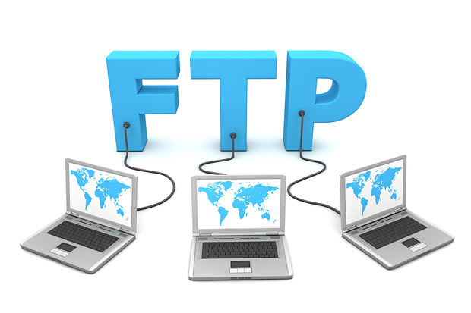
Internet applications
Email
Telnet
FTP

Slide 27
Email: Electronic Mail
Email :
E-mail, also known as electronic mail, is the most widely used and successful of Internet applications.
First email message was sent in 1971 by an engineer named Ray Tomlinson.
An email is sending text-based messages and letter to any other internet user. But now a days We can also attach picture, sound, video or document files with the e-mail.
It saves times and money.
It is easy to use and less expensive than the post.

Slide 28
Email operates across computer networks, which today is primarily the Internet.
Some early email systems required the author and the recipient to both be online at the same time, in common with instant messaging.
Today's email systems are based on a store-and-forward model. Email servers accept, forward, deliver, and store messages. Neither the users nor their computers are required to be online simultaneously.
First the sender types the message or attach the file and sends it to the mail server or email service provider, the mail server forwards it to the next server through internet and satellite. Then the message is finally received by a receiver.
Server Authentication :
To access an e-mail server, you will need to provide “authentication” – usually user id (or username) and passwords. This identifies you to the server and confirms that you have permission to check e-mail on that account. Although some servers use your e-mail address itself for the authentication user id

Slide 29
Email Address
An email address is the address of an electronic postbox that can receive (and send) email messages on a network.
Mostly e-mail address have following form
username@domainname.com
For example, in the email address "me@example.com", "me" is the username and "example.com" the domain.
Username is up to 64 character long with alphabets, number and symbol combination.
Domain name up to 256 character long.
Every user on the internet has a unique e-mail address.

Slide 30
Email has two main part: (1) Header (2) Body.
Header contains your email address, recipient's email address and subject line.
Body Contains the message where you write the content of what you want to communicate.

Slide 31
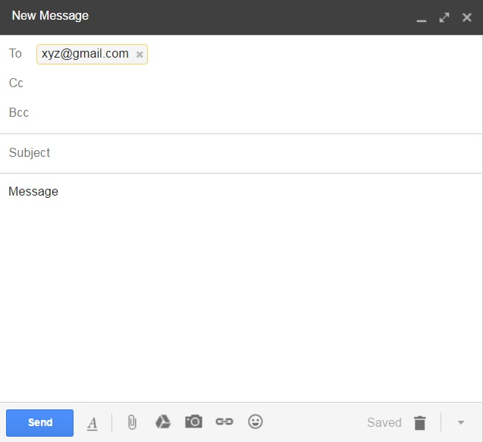
Email has two main part: (1) Header (2) Body.
Header contains your email address, recipient's email address and subject line.
Body Contains the message where you write the content of what you want to communicate.
Address/User ID
Carbon Copy
HEADER
Blind Carbon Copy
Title regarding your message
Your Message
BODY

Slide 32
CC and BCC
CC stands for Carbon Copy. When you CC people on an email, the CC list is visible to all other recipients. For example, CC bob@example.com and jake@example.com on an email, Bob and Jake will both know that the other received the email, as well.
BCC stands for “blind carbon copy.
no one but the sender can see the list of BCC recipients. For example, if you have bob@example.com and jake@example.com in the BCC list, neither Bob nor Jake will know that the other received the email.

Slide 33
The To and CC fields work similarly. Whether you put four email addresses in the To field or put one email address in the To field and three in the CC field, the four people will all receive the same email. They’ll also be able to see the email address of every other recipients in the To and CC fields.

Slide 34
E-mail is one of the protocols included with the Transport Control Protocol/Internet Protocol (TCP/IP) suite of protocols.
A popular protocol for sending and Receiving the Email
Sending e-mail is Simple Mail Transfer Protocol
Receiving it is POP3 (Post Office Protocol version 3).

Slide 35
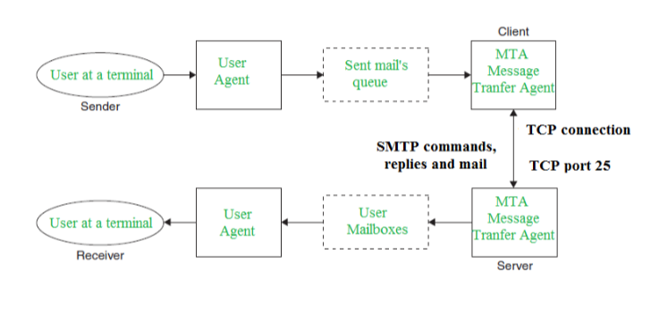
SMTP Protocol: SMTP is a set of rules defining how mail should be sent out and forwarded through the internet to its destination address.

Slide 36
POP3 Protocol :
The Post Office Protocol (POP) is an Internet standard protocol used by local e-mail clients to retrieve e-mail from a remote server over a TCP/IP connection.
Pop server is your local post office, the place where all your incoming email is routed.
IMAP Protocol:
IMAP (Internet Message Access Protocol) – Is a standard protocol for accessing e-mail from your local server. IMAP is a client/server protocol in which e-mail is received and held for you by your Internet server.

Slide 37
POP3 and IMAP are the protocols that are used to retrieve mail from the mailbox at the mail server to the recipient’s computer. Both are message accessing agents (MAA).
POP3; the user has to download the email before checking its content whereas, the user can partially check the content of mail before downloading it, using IMAP.

Slide 38
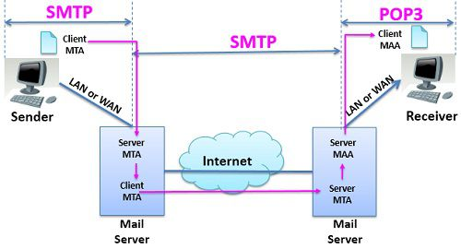
How Protocol Works:

Slide 39
TELNET protocol
TELNET (TELecommunication NETwork) is a network protocol used on the Internet or local area network (LAN) connections and which provide a bidirectional interactive communications facility.
For Example, a person has a computer in his office at new Delhi. He visit Mumbai on a family trip. But when he is free at Mumbai, he can log in his system Delhi from Mumbai and use all the databases and files and work on the system.
The user’s computer, which initiate the connection, is referred as the local computer and the machine which is accepted the connection is referred to as the remote or host computer

Slide 40
Some remote machines may require a user to have an account on machine, and may promote users for a username and password.
Telnet operates on the client/server principle.
The local computer uses a telnet client program to establish the connection and display data on the local computer’s monitor.
The remote or host computer uses a telnet server program to accept the connection and send responses to requests for information back to the local computer.

Slide 41
How telnet works?
To open a Telnet connection, you need to be at the command line. On the Start menu, type "cmd" into the Run bar (or the Search bar in Windows Vista) and click OK or hit Enter. When the command prompt window opens up, type: telnet [ip_address or hostname]
You can connect to a computer using either that computer's IP address (such as 192.168.1.10) or its name (for example, JohnsComp). In order to establish the connection, that computer must be turned on and it must be connected to the network.
If the destination computer requires a username and password to log on, you'll have to enter those credentials in order to Telnet in

Slide 42
If you try to connect to a computer via Telnet and it doesn't make the connection, there can be several reasons why.
Check that the remote computer is on and make sure it has the Telnet service running.
If you still can't connect, the remote computer's firewall settings may be blocking the connection; either turn the firewall off temporarily or allow an exception for port 23 (the port Telnet uses). If you turn the firewall off, remember to turn it back on when you are done.

Slide 43
Install Telnet on Windows
Click Start.
Select Control Panel.
Choose Programs and Features.
Click Turn Windows features on or off.
Select the Telnet Client option.
Click OK. A dialog box appears to confirm installation. The telnet command should now be available.

Slide 44
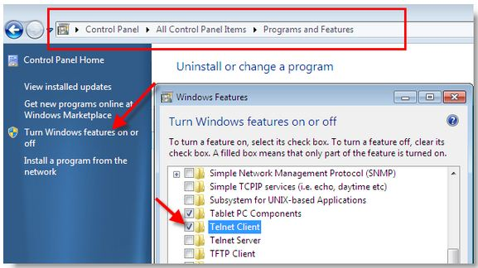

Slide 45

Team Viewer
Team Viewer is an excellent screen-sharing and file-transfer app.
Team Viewer is a Web 2.0 program that allows users to connect to each other’s personal computers, via internet, and control his/her screen.
Team Viewer also provides more features such as video calling and voice transmission.
In addition, this program allows users to transfer files from one PC to another.
Besides that, this program allows the user to display his/her screen to the other user

Slide 46
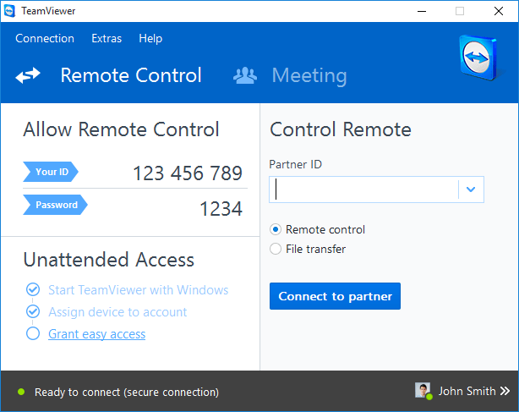

Slide 47
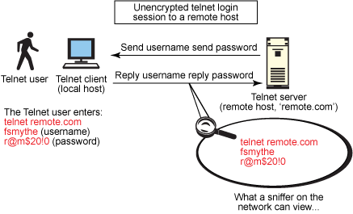

Slide 48
FTP : File Transfer Protocol
FTP is a part of TCP/IP protocol suite.
It is the protocol or set of rules, which enables files to be transferred between computers.
FTP is powerful tool which allows files to be transferred from “computer A” to “Computer B” or vice versa.
FTP works on client/server principles.
A client program enables the user to interact with a server to access information and services on the server computer.

Slide 49
Files that can be transferred are stored on computer called FTP servers.
To access these files, an FTP client program is used.
Transferring files from a client computer to a server computer is called "uploading" and transferring from a server to a client is "downloading".

Slide 50
How it works?
First, you as client make a TCP control connection to the FTP server's port 21 which will remain open during the transfer process. In response, the FTP server opens a second connection that is the data connection from the server's port 20 to your computer.

Slide 51
There are two mode for connection
1) Active
2) Passive
The FTP server may support Active or Passive connections, or both.
In an Active FTP connection, the client opens a port and listens and the server actively connects to it.
In a Passive FTP connection, the server opens a port and listens (passively) and the client connects to it.

Slide 52
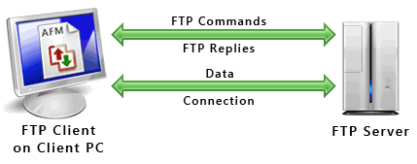
Using the standard active mode of FTP, your computer communicates the port number where it will stand by to receive information from the controller and the IP address--internet location--from which or to which you want files to be transferred

Slide 53
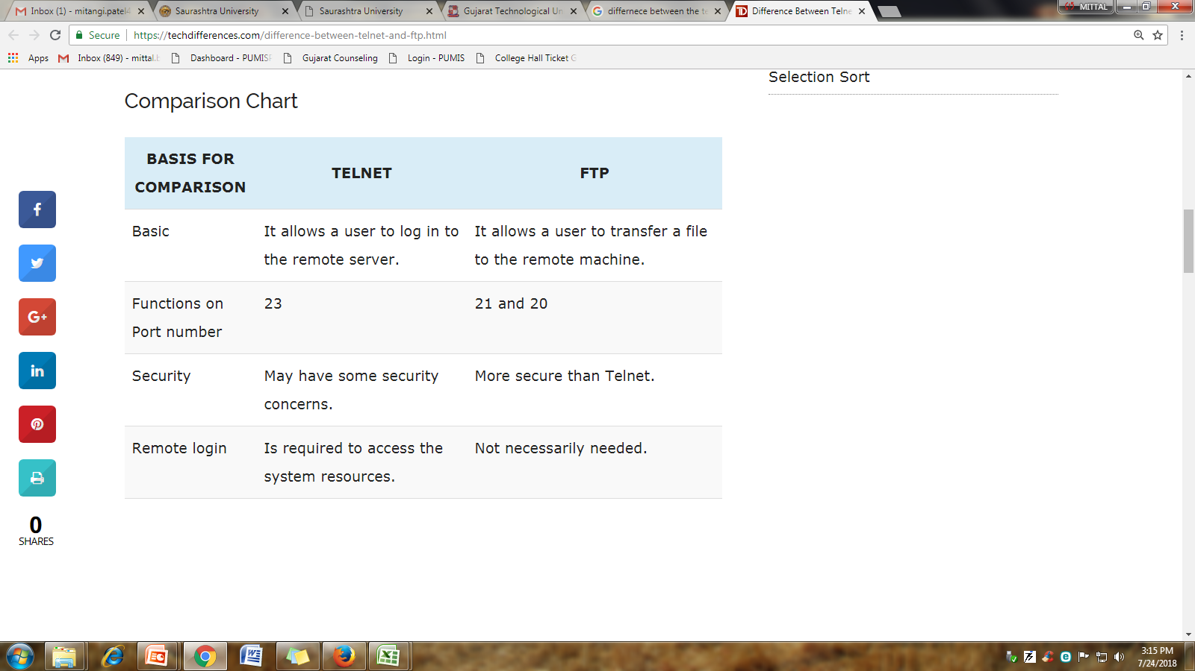
Difference between TELNET & FTP

Slide 54
WWW (World Wide Web)
The World Wide Web (abbreviated WWW or the Web) is an information space where documents and other web resources are identified by Uniform Resource Locators (URLs) can be accessed via the Internet.
Tim Berners-Lee, a British scientist at CERN, invented the World Wide Web (WWW) in 1989.
The web was originally conceived and developed to meet the demand for automatic information-sharing between scientists in universities and institutes around the world.
On 30 April 1993 CERN put the World Wide Web software in the public domain.
The World Wide Web (WWW) is a network of online content that is formatted in HTML and accessed via HTTP.
HTTP protocol is the method used to transfer web pages to your computer.

Slide 55
The World Wide Web (WWW or Web for short) is the part of the Internet that you can access using a web browser such as Internet Explorer or Firefox, etc.
With a web browser, one can view web pages that may contain text, images, videos and navigate between them via hyperlinks.
The World Wide Web consists of all the public Web sites connected to the Internet worldwide, including the client devices (such as computers and cell phones) that access Web content.
The internet Is the actual network of networks where all information resides.
Things like Telnet, ftp and email are part of the internet but not part of www.
HTTP protocol is the method used to transfer web pages to your computer.

Slide 56
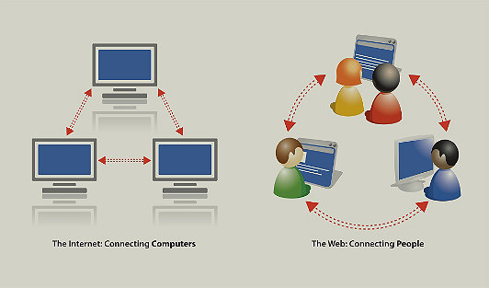

Slide 57
The World Web is based on these technologies:
HTML - Hypertext Markup Language
HTTP - Hypertext Transfer Protocol
Web servers and Web browsers
WWW Components :
1) Structural component
-client
-servers
-caches
-Internet
2) Semantic Components
-Hyper Text Transfer Protocol
-Hyper Text Markup Language
3) Extensible Markup Language(XML)
-Uniform Resource Identifiers(URLs)

Slide 58
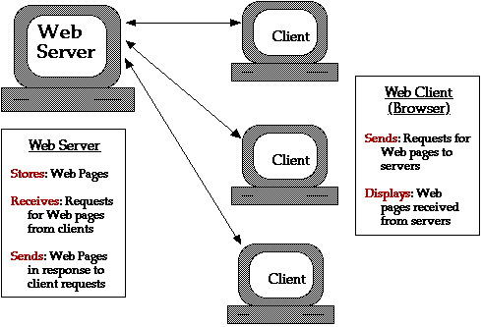

Slide 59
Web Page :
A web page, or webpage, is a document that is suitable for the World Wide Web and web browsers.
A web page is a unit of information, often called a document that is available via www.
A web browser displays a web page on a monitor or mobile device.
A web page can be longer than one computer screen and can use more than one piece of paper when it is printed out.
A Web page is created using HTML. It consist of standardized codes or “tags”, that are used to define the structure of information on a web page.
These codes enable web pages to have many feature including bold text, headings, paragraph breaks and numbered or bulleted lists.
Web Pages have two types :
(1) Static
(2) Dynamic

Slide 60
Static web page :
"Static" means unchanged or constant.
static Web pages contain the same prebuilt content each time the page is loaded
Standard HTML pages are static Web pages.
Each time an HTML page is loaded, it looks the same. The only way the content of an HTML page will change is if the Web developer updates and publishes the file.
Static website is the basic type of website that is easy to create. You don't need web programming and database design to create a static website. Its web pages are coded in HTML.
The codes are fixed for each page so the information contained in the page does not change and it looks like a printed page.

Slide 61
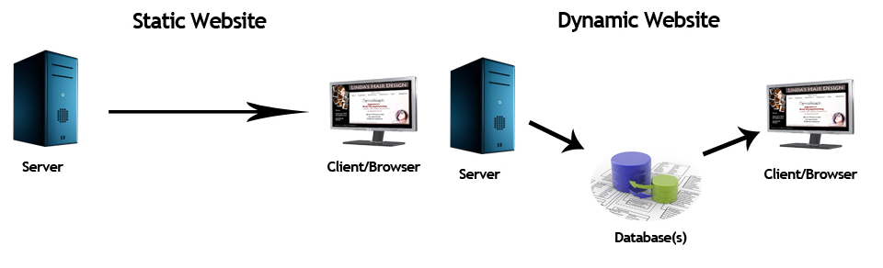
Dynamic web pages :
A dynamic web page is a web page that displays different content each time it's viewed. For example, the page may change with the time of day.
It accesses content from a database or Content Management System (CMS). Therefore, when you alter or update the content of the database, the content of the website is also altered or updated.
Dynamic website uses client-side scripting or server-side scripting, or both to generate dynamic content.

Slide 62
There are two types of dynamic web pages.
1)Client-Side Scripting
2)Server-Side Scripting

Slide 63
Client-side scripting refers to the programs that are executed on client-side.
Client-side scripts contains the instruction for the browser to be executed in response to certain user’s action.
It is processed using client side scripting such as JavaScript. And then passed in to Document Object Model (DOM).
Client-side content is content that's generated on the user's computer rather than the server.
In these cases, the user's web browser would download the web page content from the server, process the code that's embedded in the web page, and then display the updated content to the user.

Slide 64
server side scripting, the software runs on the server and processing is completed in the server then plain pages are sent to the user.
For example, login pages, forums, submission forms, and shopping carts, all use server-side scripting since those web pages change according to what is submitted to it.
Scripting languages such as PHP, ASP, ASP.NET, JSP, ColdFusion and Perl allow a web page to respond to submission events.

Slide 65
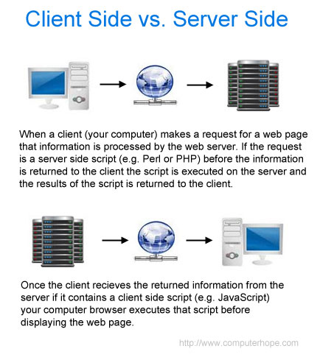

Slide 66
For more please visit:
https://www.javatpoint.com/website-static-vs-dynamic
https://www.doteasy.com/web-hosting-articles/what-is-a-dynamic-web-page.cfm
http://smallbusiness.chron.com/difference-between-dynamic-static-pages-69951.html
https://www.tutorialspoint.com/internet_technologies/web_pages.htm
https://www.computerhope.com/jargon/w/webpage.htm

Slide 67
HTTP (Hyper Text Transfer Protocol)
The Hypertext Transfer Protocol (HTTP) is application-level protocol for collaborative, distributed, hypermedia information systems.
It is the data communication protocol used to establish communication between client and server.
HTTP is TCP/IP based communication protocol, which is used to deliver the data like image files, query results, HTML files etc on the World Wide Web (WWW) with the default port is TCP 80.

Slide 68
The Basic Characteristics of HTTP (Hyper Text Transfer Protocol):
It is the protocol that allows web servers and browsers to exchange data over the web.
It is a request response protocol.
It uses the reliable TCP connections by default on TCP port 80.
Http is Connectionless means after making a request the client, disconnect from the server. After that when the response is ready the server re- established the connection again and deliver the response to the client.
HTTP is also known as CL-mode communication
It is stateless means each request is considered as the new request. In other words.
Server does not maintain the state of the client. That is, when the response is delivered, the server simply forgets the client. If the client wants the same data, it must again establish a new connection, send request and receive response and the same earlier process is to be repeated. For this reason, HTTP protocol is treated as stateless protocol.

Slide 69
if the client would like to request the same server 100 times, the client should establish a new connection 100 times as the server closes the connection for each request when the response is delivered.
why HTTP was designed as connectionless?

Slide 70
HTTP Protocol was designed as connectionless for the reason, the server resources should be shared equally by all the clients throughout world. If one client holds the server with 100 requests, by all the requests are answered, the server cannot allocate time for other clients.

Slide 71
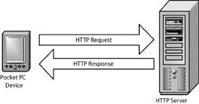
When user selects a hypertext link, the client program on their computer uses HTTP to contact the server, identify a resource, and ask the server to respond with an action.
The server accepts the request, and then uses HTTP to respond to or to perform the action.
Usually, hypertext links will be blue in colour and will be underlined. When you move the mouse pointer over a hyperlink, the pointer changes its shape to that of hand.
http:// in front of the address tells the browser to communicate over HTTP.
http://www.microsoft.com
http://www.ibm.com
http://www.netscape.com
Resources

Slide 72
URL Registration
URL is the abbreviation of Uniform Resource Locator.
It is the global address of documents and other resources on the World Wide Web. For example, www.facebook.com, www.google.com.
A URL is one type of Uniform Resource Identifier (URI).
URL strings consist of three parts
1) Network Protocol (URL protocol)
2) Host name or address (IP address or Domain Name) www.yahoo.com
3) File or resource location
Syntax : protocol :// host / location
e.g.
1 2 3
https://www.tutorialspoint.com/internet_technologies/website_url_registration.htm

Slide 74
More about URL
http://www.webopedia.com/TERM/U/URL.html
http://searchnetworking.techtarget.com/definition/URL
https://www.lifewire.com/definition-of-uniform-resource-locator-817778
http://www.wikihow.com/Register-a-Domain-Name
http://www.smarta.com/advice/web/business-websites/how-to-register-a-domain-name/

Slide 75
Web Browser
A web browser is a software application that people use in order to view web pages on the internet.
It can be used to upload or download files on FTP servers.
It uses security methods such as SSL and TLS to secure internet traffic.
As a client/server model, the browser is the client run on a computer that contacts the Web server and requests information. The Web server sends the information back to the Web browser which displays the results on the computer.
The most popular web browsers that are used today are Mozilla Firefox, Google Chrome, Microsoft Internet Explorer, Apple Safari and the Opera browser.
For example, if you were to visit www.google.com, you are actually viewing a file that is displayed using the web browser. This file is drafted using the hyper text markup language, or HTML for short.
The two most popular browsers are Microsoft Internet Explorer and Firefox. Other major browsers include Google Chrome, Apple Safari and Opera.

Slide 76
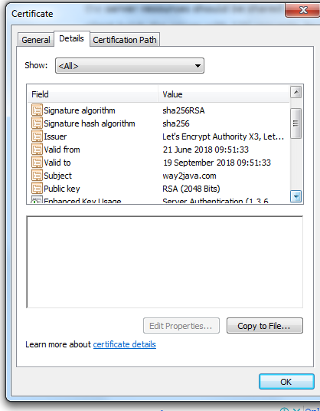
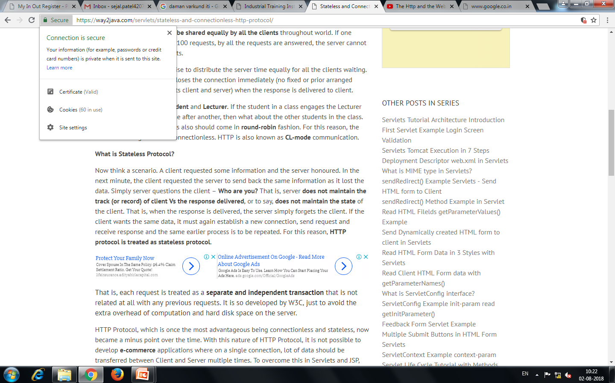

Slide 77
Web Server
A Web server is a computer that is set up with software and networking capabilities to deliver Web pages on the Internet or an Intranet.
Web servers use programs such as Apache or IIS(Internet Information Server) to deliver Web pages over the http protocol.
Apache is HTTP web server which is a free and open-source cross-platform web server,
The primary function of a web server is to store, process and deliver web pages to clients.
The communication between client and server takes place using the Hypertext Transfer Protocol (HTTP). Pages delivered are most frequently HTML documents, which may include images, style sheets and scripts in addition to text content.

Slide 78
A single web server may support multiple websites.
Any computer can be used as a Web server, as long as it is connected to the Internet and has the appropriate software installed.

Slide 79
Any computer can be used as a Web server, as long as it is connected to the Internet and has the appropriate software installed.
Web server is a program that uses HTTP to serve files that create web pages to users in response to their requests, which are forwarded by their computers HTTP connection.
For about web server and web browser
http://www.webopedia.com/TERM/B/browser.html
https://en.wikipedia.org/wiki/Web_browser
http://study.com/academy/lesson/what-is-a-web-browser-definition-examples-quiz.html
http://www.fastwebhost.in/blog/what-is-web-servers-different-types-of-web-servers/
https://en.wikipedia.org/wiki/Web_server

Slide 80
Thank You.

